Slide 1









MARKET TRENDS IN INDIAN AGRICULTURE: A STATISTICAL PERSPECTIVE

Slide 2


  Alina George (81323004)
  Muhannad Mohammad Ali (81323015)
  Snehal P (81323021)
Prepared By

Slide 3





INTRODUCTION
This project involves conducting statistical analysis on agricultural market data collected from various states and districts across India. The dataset includes key variables such as the name of the state, district, and market, along with details about the commodity and its variety. It also captures important market indicators including arrival quantity, minimum price, maximum price, and modal price. By analyzing these variables, the project aims to identify pricing patterns, regional trends, and market behavior that can support better decision-making in agricultural planning and policy.

Slide 4


⚙️ OPERATIONS OVERVIEW
The project workflow is structured into four key stages:
Understanding and Gathering the Dataset
Visualizations
Exploratory Data Analysis (EDA)
Creating clear, informative charts and graphs to communicate insights effectively.
Initial exploration of the dataset structure, variables, and source to ensure relevance and completeness.
Data Cleaning
Handling missing values, correcting inconsistencies, and preparing the data for analysis.
Identifying patterns, distributions, and relationships among variables using statistical summaries and plots.

Slide 5
Understanding the Dataset

Slide 6

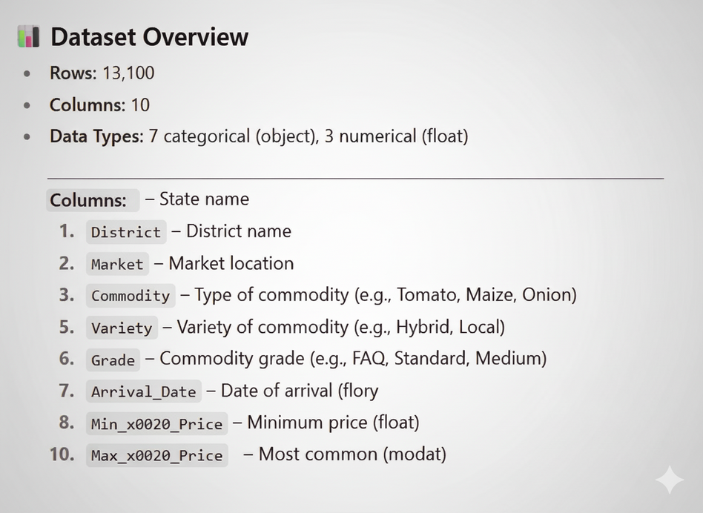
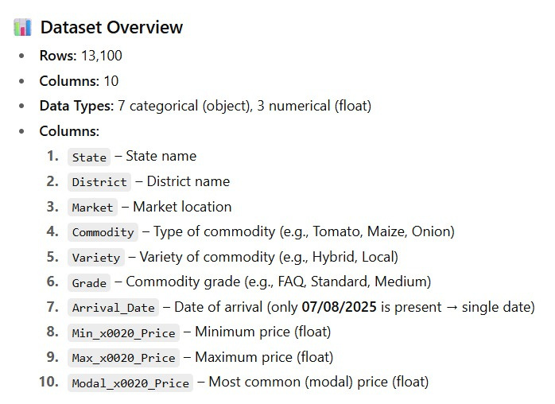
DATASET OVERVIEW

Slide 7




📊 DATA CHARACTERISTICS
  States: 25 unique (e.g., Tamil Nadu, Andhra Pradesh, etc.)
  Districts: 369 unique
  Markets: 948 unique
  Commodities: 187 unique (Top = Onion with 490 entries)
  Varieties: 340 unique (Top = "Other")
  Grades: 6 unique (Top = "Local", then "FAQ")
  Dates: Only one (07/08/2025) → dataset is a snapshot of a single day’s mandi prices

Slide 8
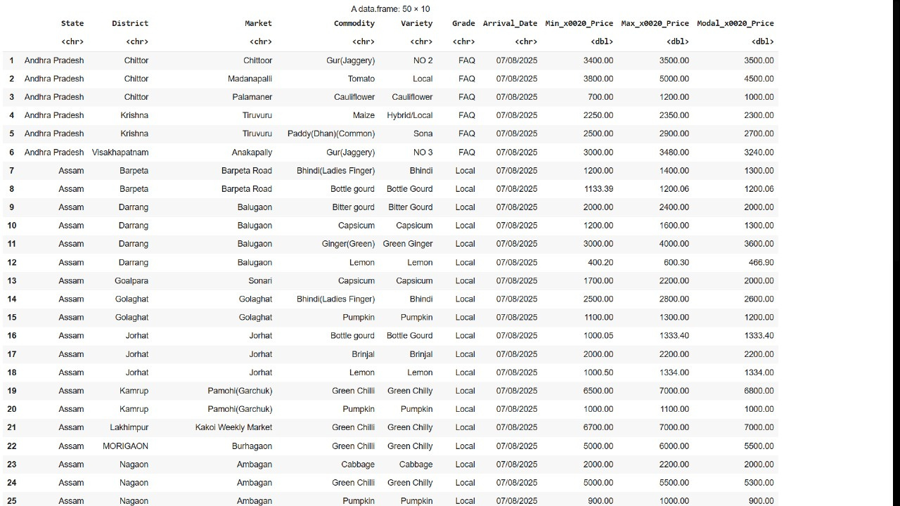
Raw Dataset

Slide 9
Data Cleaning

Slide 10

Data Cleaning Techniques
1.Renaming Columns
2.Missing values
Give columns meaningful and consistent names to make the dataset easier to understand and work with
Identify any null or missing data in the dataset to decide whether to fill, remove, or impute them
3.Detect and Handle Outliers
4.Standardize Categorical Values
Look for unusual or incorrect price entries and Remove or adjust extreme values in numeric columns that do not represent typical data to improve model accuracy.
Ensures consistency in text data by correcting spelling variations, extra spaces, and inconsistent naming or casing (e.g., "Kerala" vs "kerala" or "Green Chili" vs "Green Chilli").

Slide 11
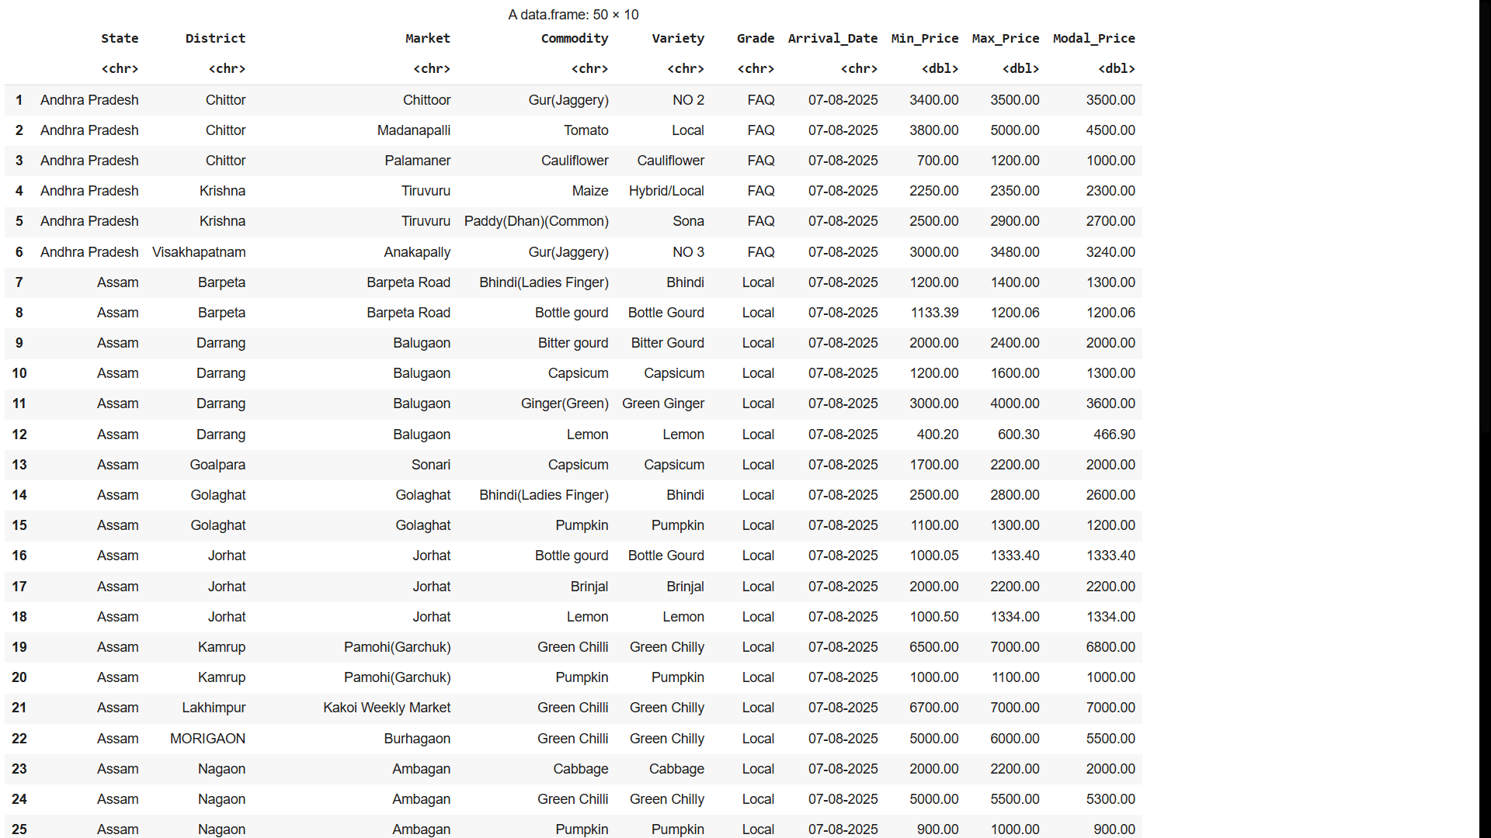
Cleaned
Dataset

Slide 12
Exploratory Data Analysis (EDA)

Slide 13
2.Descriptive Statistics for Numeric Variables
1.Basic Summary
  Variance → how spread out values are.
  Standard Deviation → typical deviation from mean.
  Skewness → whether data is left- or right-skewed.
  Kurtosis → how peaked or flat the distribution is.
  Packages like psych and skimr give detailed numeric insights.
  Purpose: To detect patterns like stability, outliers, or irregular distributions in prices.
  The summary() function provides an overview of numeric variables.
  It shows:
  Minimum, 1st Quartile, Median, Mean, 3rd Quartile, Maximum.
  Also counts NAs if present.
  Purpose: To quickly understand the range and central tendency of the dataset.

Slide 14
3.Frequency Tables for Categorical Variables
4.Grouped Summary (e.g., by State or Commodity)
  Used for categorical columns (like State, Commodity).
  table() shows the count of each category, while prop.table(table()) gives proportions.
  Purpose: To see distribution of observations across categories.
  Example: Which states/commodities dominate mandi transactions.
  Uses group_by() + summarise() in dplyr to calculate statistics within groups.
  Typical grouped stats:
  Mean, min, max price per state.
  Average price per commodity.
  Purpose: To compare categories and discover regional or commodity-specific trends.
  Example: Average tomato prices in Kerala vs Karnataka.

Slide 15
5.Spread analysis by Commodity or State
  Defined Price Spread = Max_Price – Min_Price.
  Added new column Price_Spread.
  Generated summary statistics for price spread.
  Grouped spread by:
  Commodity → Identified which crops show widest fluctuations.
  State → Compared intra-state price variations.

Slide 16
Visualizations

Slide 17
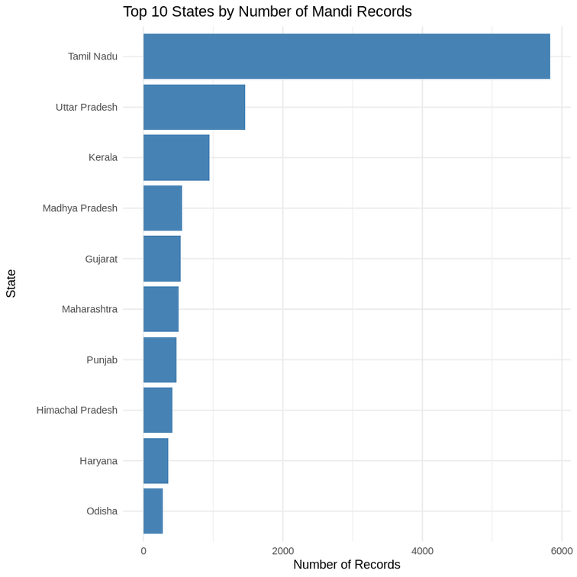
BarChart
Top 10 States by Record Count
  The bar chart for states will likely show a highly imbalanced distribution.
  A few states, such as Uttar Pradesh or Rajasthan, will have a significantly higher number of mandi records compared to others.
  data collection is not uniform across all states
  these states are major agricultural hubs with extensive market activity.

Slide 18
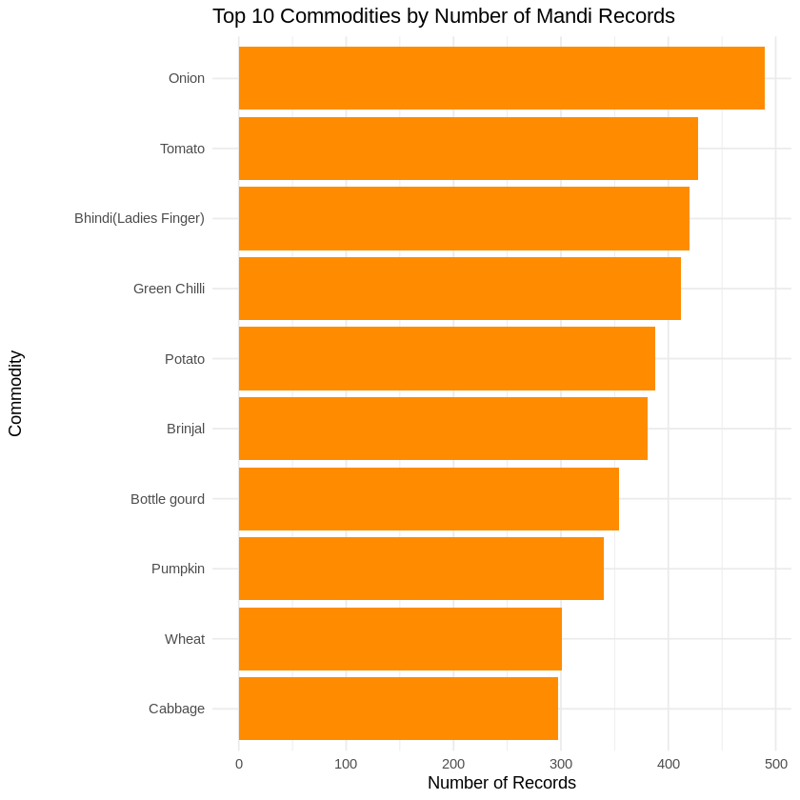
Bar Chart
Top 10 Commodities by Record Count
  highlight which crops are most frequently traded and reported in the dataset
  Common staples like Tomato, Potato, and Onion will probably dominate the chart, indicating their importance in the agricultural economy.

Slide 19
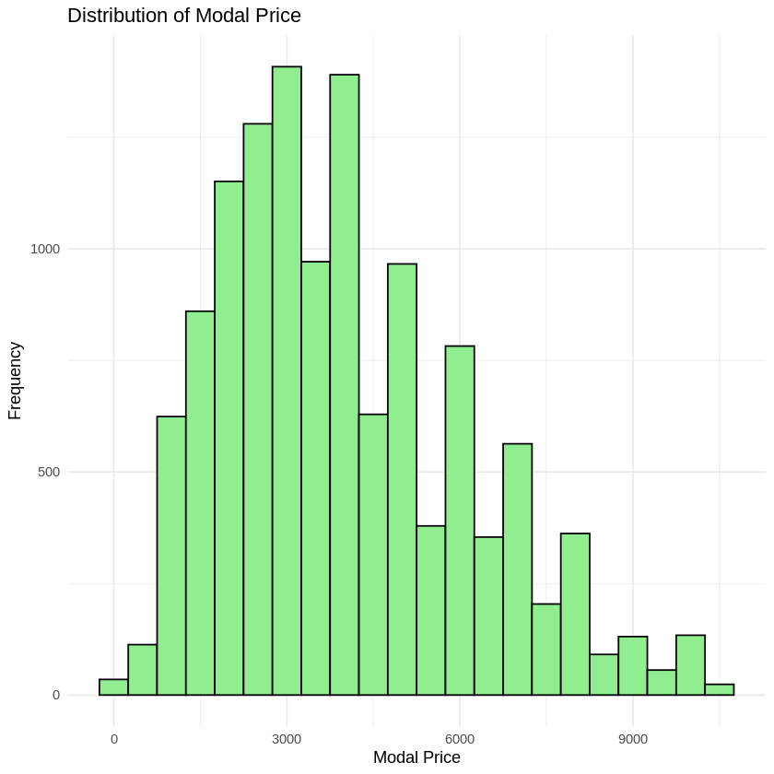
Histogram
Distribution of Modal Price
  The histogram of Modal_Price will reveal the central tendency and spread of prices.
  observed a right-skewed distribution, meaning most commodities have a lower modal price, while a smaller number of commodities have very high prices.
  This skewness suggests that the prices are not normally distributed and that there are high-value commodities in the dataset.
  The presence of multiple peaks could also indicate distinct pricing clusters for different types of goods (e.g., staple grains vs. specialty vegetables).

Slide 20
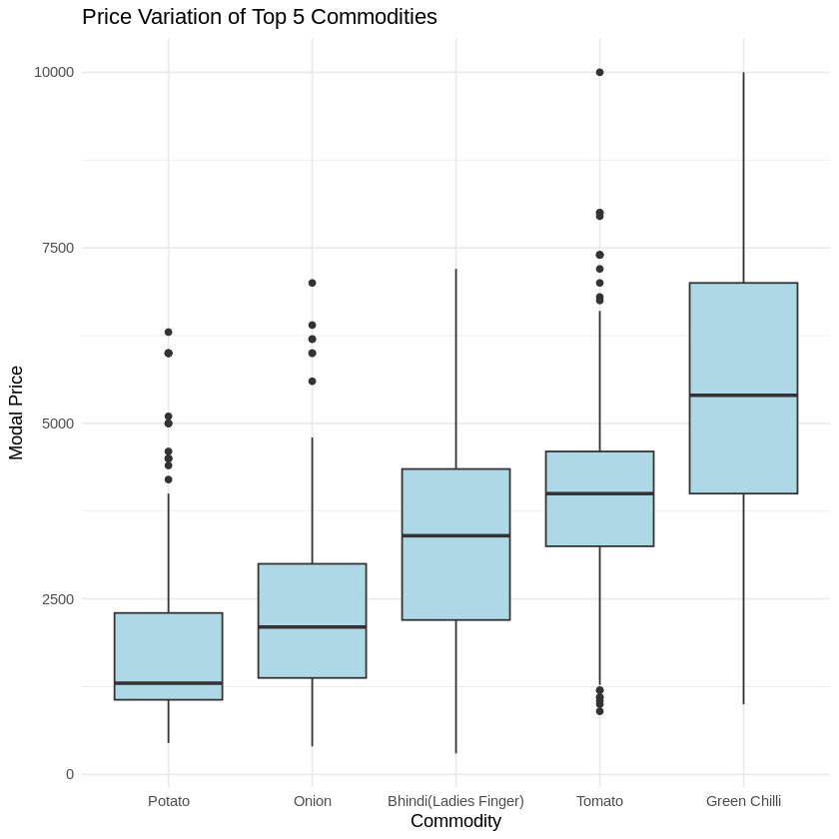
Boxplots
Price Variation by Commodity
  represent the insights from grouped summaries.
  compares the median, interquartile range (IQR), and outliers for the top commodities.
  For example, a commodity like Onion might have a tight box with few outliers, indicating stable and predictable prices, while a specialty item or a highly perishable vegetable might have a wider box and many outliers, suggesting high price volatility and greater risk for farmers and traders.

Slide 21
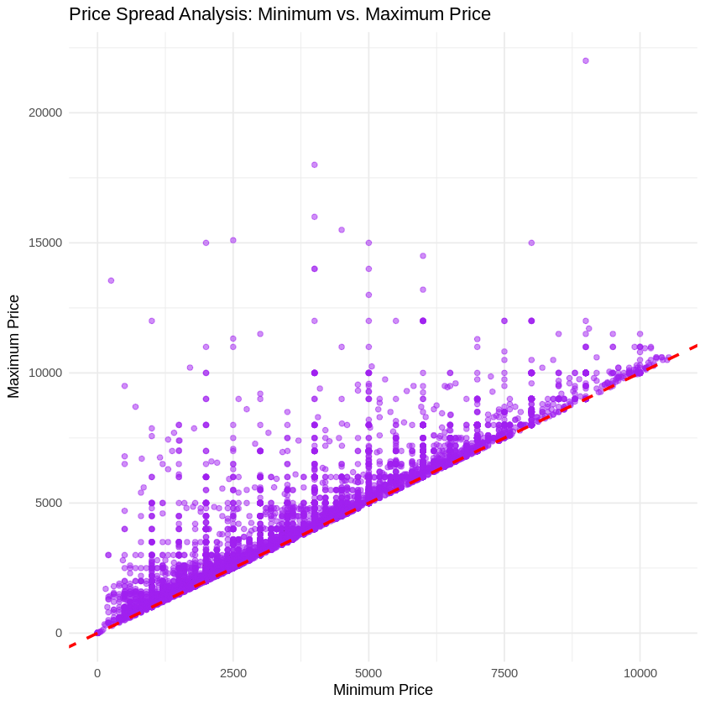
Scatter Plot
Price Spread
  crucial for understanding the relationship between Min_Price and Max_Price,ie price spread = Max_Price - Min_Price.
  If the points cluster tightly along the line of perfect equality (red), it suggests that the spread is consistently small.
  The plot will likely show that as Min_Price increases, the price spread also tends to increase. This means that higher-priced commodities often exhibit wider price fluctuations, while lower-priced commodities have more stable price bands.
  The points farthest from the dashed line represent the anomalies where the difference between the minimum and maximum prices is unusually large.

Slide 22



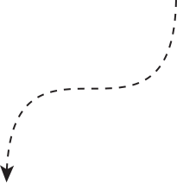

THANK
YOU!

